Slide 1
An Analysis of the Trump Tax Cuts by a Two-Handed Economist
Geoffrey Woglom
Amherst College
© 2017 McGraw-Hill Education. All rights reserved. Authorized only for instructor use in the classroom. No reproduction or distribution without the prior written consent of McGraw-Hill Education.

Slide 2
This is NOT the of Ideal Policy Advising
Speaking to Bloomberg on March 7, Navarro heaped praise on his boss and described his own role as that of an enabler.
“This is the president’s vision. My function, really, as an economist is to try to provide the underlying analytics that confirm his intuition. And his intuition is always right in these matters,”

Slide 3
Government Finances: Where We Were
(Economic Report of the President & CBO)
Total Government (billions of dollars) 2017
Federal
Receipts | $3,316
Expenditures | 3,982
State and Local
Receipts | 2,503
Expenditures | 2,677
Federal Debt and Deficits
Deficit -665 |  |  | -3.5% of GDP
Total Privately Held Debt 14,665 |  |  | 76.8%
GDP |  |  | $19,500

Slide 4
Total Federal Spending
Entitlements: Income Security + Medicare + Social Security = 54%
Non-Discretionary: Entitlements + Interest on the Debt = 61%

Slide 5
Total Federal Taxes
Most Revenue comes from Income and “Payroll Taxes”=
33+48=81%
Estate or “Death” Tax is less than 1%

Slide 6
Who Paid Federal Taxes (2017)
Quintiles | Exp Cash Income | Income Tax | Payroll Tax | Corp Tax | Estate Tax | Excise Tax | All Federal
0-20 | 4.4 | -2.1 | 4.0 | 1.5 | 0.1 | 10.6 | 1.0
21-40 | 8.7 | -1.1 | 9.5 | 4.3 | 0.1 | 15.0 | 3.9
41-60 | 14.2 | 5.3 | 16.2 | 8.5 | 0.2 | 17.4 | 10.0
60-80 | 20.8 | 14.3 | 24.9 | 14.8 | 8.2 | 20.5 | 18.4
Top 20 | 52.1 | 83.6 | 45.2 | 70.0 | 91.0 | 36.2 | 66.6
Addendum
Top 1 Percent | 15.3 | 38.0 | 5.2 | 33.6 | 60.5 | 7.1 | 25.1
Top 0.1 Percent | 7.4 | 18.9 | 1.3 | 21.7 | 27.5 | 2.7 | 12.7
Source: Urban-Brookings Tax Policy Center Microsimulation Model (version 0217-1).

Slide 7
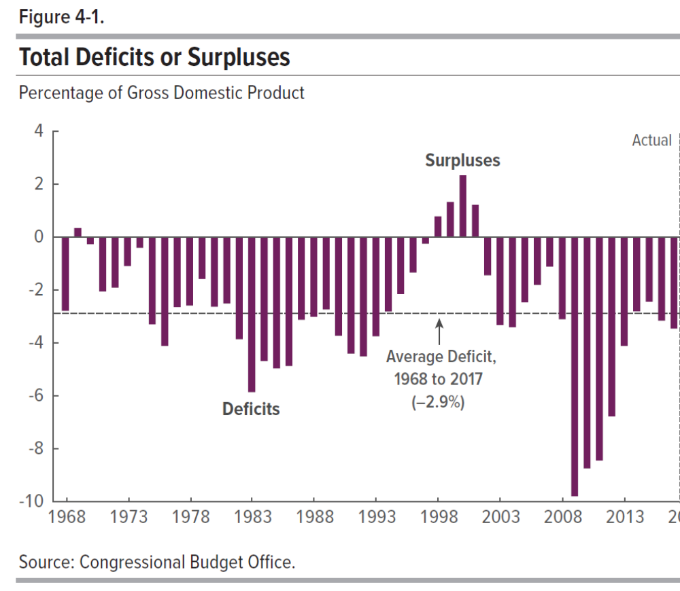
A Brief History of Deficits

Slide 8
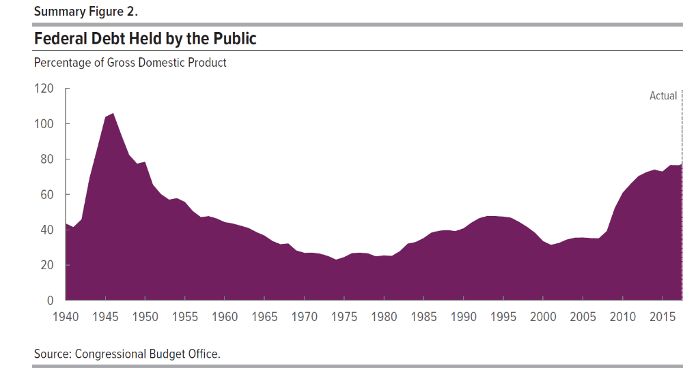
The Resulting Debt

Slide 9
Changes from Tax Cuts and Jobs Act (TCJA)
Individual Income Taxes
  Lowers “marginal rates.”
  Eliminates personal exemptions, but raises standard deduction to $24,000 for couple.
  Limits deductibility of State and Local taxes to $10,000.
  Most provisions “sunset” after 2025.
Corporate Income Tax (permanent)
  Lowers statutory rate from 35% to 21%
  Cuts interest deductibility; provides investment incentives for 5 years.
  Attempts to eliminate “corporate inversions.”
Estate Taxes: Doubles exemption to $22.4 million for a couple.

Slide 10
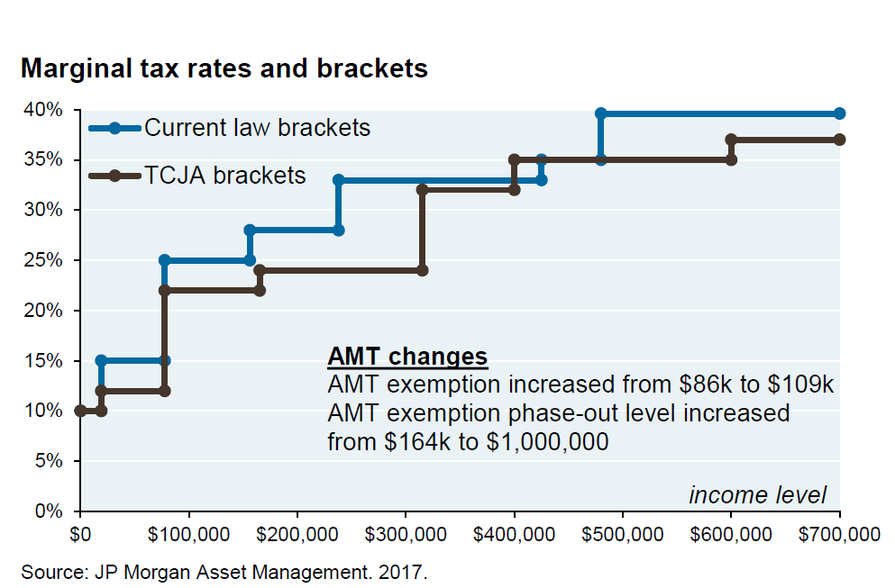
Tax Brackets

Slide 11
Tax Cuts and the Economy
Taxes Cuts Affect:
The Distribution of Income and Inequality.
GDP or total output by increasing:
  Demand
  Supply via incentives to: Work, save , and invest.
Deficits and the Debt.

Slide 12
Two Important Tax Rates
To understand the effect of tax cuts on the economy, we must distinguish between average and marginal tax rates
Marginal tax rate extra tax from earning $1 more.
Average tax rate the percentage of your total income paid in taxes.
Marginal rates matter for incentives; average rates matter for income distribution.

Slide 13
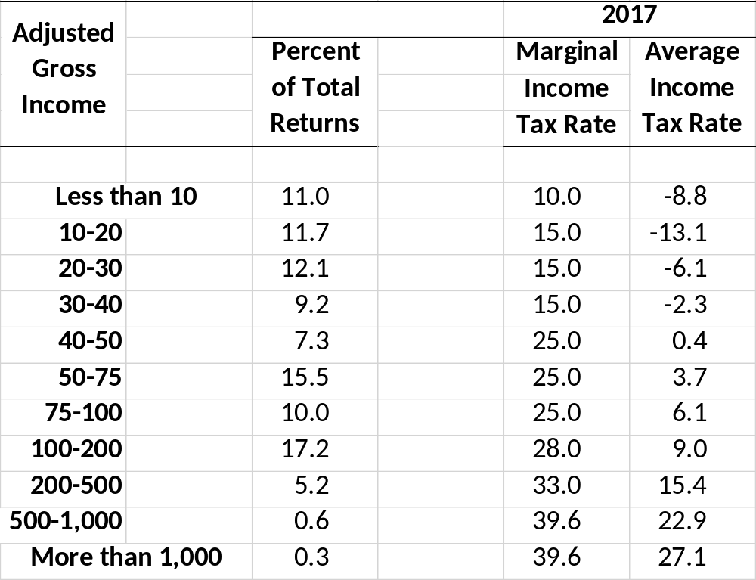
Marginal And Average Tax Rates in 2017
The two rates differ because of:
1. Deductions and Credits. 2. Increasing marginal rates.
Progressive Taxes: average tax rate increases with income. US income tax is progressive.
Progressive Taxes reduce income inequality.

Slide 14
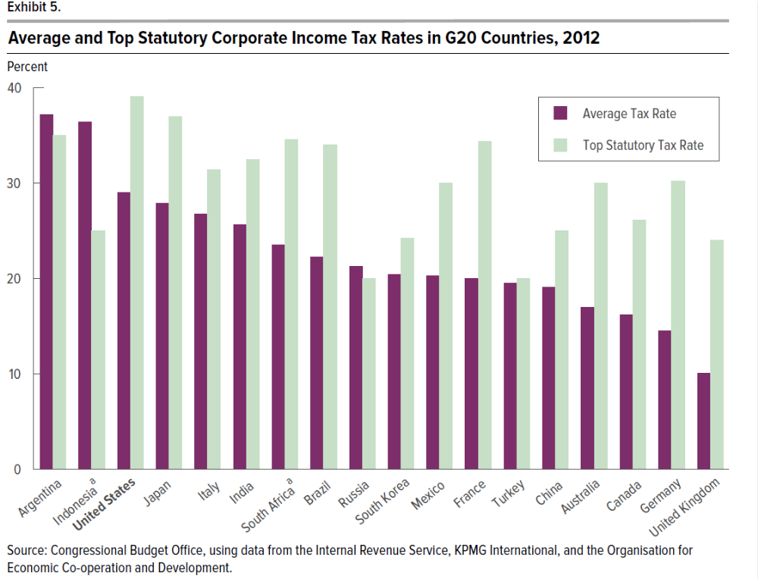
Marginal/Average Distinction
“When it comes to the business tax we are dead last, can you believe that?” Trump said during his remarks in Springfield, Missouri. “We have totally surrendered our competitive edge to other countries."

Slide 15
Marginal and Average Corporate Taxe Rates
In 2012,
A corporation reporting $1 more in income would pay almost $0.40 more in federal and state and local taxes.
On average, a corporation’s taxes were about 28% of its income.
Economists of all political stripes believed that the corporate tax code needed to be reformed. But the statement that corporate taxes were highest in the US is false.

Slide 16
I. Two Statements on Fairness of TCJA
Tax Report, WSJ, 4/6/2018:
“One of the least discussed parts of America’s income tax is how progressive it is, and the tax overhaul didn’t change that fact. In 2018, top [20 percent] will pay a higher share of income taxes.
For 2018, …, they will pay about 87% of income taxes, up from about 84% last year.”
Bernie Sanders, 12/1/2017:
“But tonight, we are presumably going to pass legislation, when at a time of massive income and wealth inequality, 62% of the tax benefits go to the top 1%.”
And the two statements are both right!

Slide 17
The Changing Share of the Income Tax
Changes in the Shares of Taxes due to Income Tax Provisions of TCJA
What Bernie should have said.
Quintiles | Income | Income Tax 2017 | Income Tax 2018
0-20 | 4.4 | -2.1 | -2.5
21-40 | 8.7 | -1.1 | -2.0
41-60 | 14.2 | 5.3 | 4.3
60-80 | 20.8 | 14.3 | 13.2
Top 20 | 52.1 | 83.6 | 86.9
Addendum
Top 1 Percent | 15.3 | 38.0 | 43.3
Top 0.1 Percent | 7.4 | 18.9 | 22.2
Share of Tax Cut
0.9
5.6
12.2
19.4
63.6
16.8
4.7
Good: Soak the Rich!

Slide 18
Tedious arithmetic
If the share of taxes the top 20 paid is more than the share of the tax cut received, the share of the top 20 must go up.
  Initial share, 84%
  Share of Tax reduction, 64%
But that doesn’t mean that the top 20 are relatively worse off.
Taxes are more important to the affluent.
The key question (to me) is did the changes make after-tax incomes more or less equal?

Slide 19
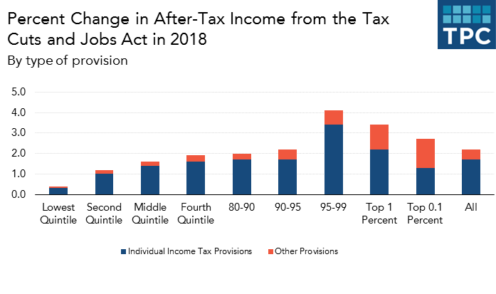
My View on Most Relevant Measure of Fairness
My view: TCJA increased income inequality

Slide 20
II.1 Tax Cuts and GDP
Tax cuts put more money in the private sector raising consumption and investment.
(Kennedy Tax cut of 1964)
CBO, estimates that demand-side effects of the tax cuts will add about 0.7 percent to GDP in 2019 and 2020. Thereafter, changes in real GDP are driven by the total supply of goods and services.
The economy is already at full employment. Fed will raise interest rates faster to prevent more rapid growth in demand, output and inflation!

Slide 21
II.2 Incentives and the Tax Code
The tax code has important effects on incentives or the after-tax benefit of engaging in an activity.
Easiest example: sin taxes raise the taxes of individuals who smoke, consume alcohol (drive?).
The marginal tax rate reduces the incentive to work, save and for corporations to invest.
Finally, tax deductions and credits increase the incentive to engage in activities such as buying a home or giving to charity, corporations investing, poor people working (EITC).

Slide 22
A Side Note on the Incentive for Charitable Giving
If you itemize deductions, the cost of a $1 donation is less than a $1.
  If you are in the 10% tax bracket, the $1 gift lowers your taxable income by $1.00 and lowers your taxes by $0.10. Therefore, the donations costs only $0.90.
  If you are in the 25% bracket, the $1 donation lowers your taxes by $0.25; therefore the donation costs $0.75.
Tax code makes the “cost of giving” less for more affluent donors because they get larger deductions and are more likely to itemize.

Slide 23
So, TCJA raised the after-tax cost of charity!
Yes, because everyone’s marginal tax rates went down.
More importantly, because it will drastically reduce the percentage of itemizers. (offsetting benefit, tax simplification).
Doubling the standard deduction to $24,000 (and limiting the tax deductibility of state and local taxes to $10,000) will reduce itemizers.
If you don’t itemize, a $1 charitable gift costs $1.

Slide 24
TCJA and Percent of Itemizers
Quintiles | Old Law | TCJA
0-20 | 0.4 | 0.1
21-40 | 4.6 | 1.0
41-60 | 18.6 | 5.0
60-80 | 43.8 | 14.3
Top 20 | 76.5 | 40.0
Total | 26.4 | 10.9
Addendum
Top 1 Percent | 92.1 | 77.0
Top 0.1 Percent | 92.9 | 85.7

Slide 25
Ways to reduce taxes while being charitable
Bunch your charitable donations in 1 year.
  Give a substantial gift of appreciated securities to a “charitable trust.” (e.g., Vanguard, Fidelity).
  You can then direct the trust to “make a grant,” to the charity of your choice (minimum $500).
Have your RMD from pensions go directly to a charity.
Sadly, you cannot direct RMDs to a charitable trust.
Usual caveats apply: consult your tax accountant.

Slide 26
Back to II.2: Output & Incentives
Reducing taxes on work effort, saving and investment increases these activities raising the total supply of goods and services.
Here again, the marginal/average rate distinction is crucial.
The lower the marginal rate, the less the disincentive.

Slide 27
Tax Incentives Made Ronald Reagan a Republican
At his Hollywood height, actor Ronnie Reagan was making $400,000 per picture. With the top federal tax rate over 90 percent, Reagan used to tell his White House chief of staff Donald Regan, he always chose to “loaf” around rather than make more than two pictures a year.
“Why should I have done a third picture, even if it was Gone with the Wind?” Regan remembers Reagan asking. “What good would it have done me?”
http://toomuchonline.org/the-tax-that-turned-ronald-reagan-right/

Slide 28
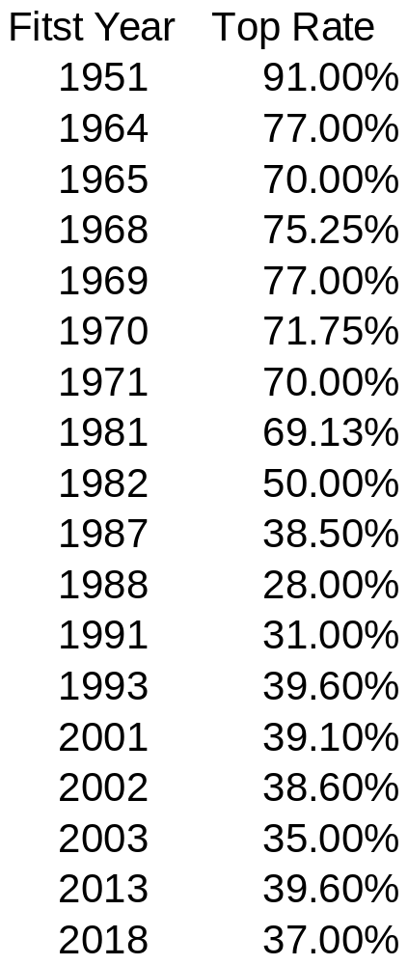
History of the Top Marginal Rate
The 91% rate in 1963 applied to couple’s income of about $1.4 million in today’s $s.
Don’t forget the marginal average distinction.
Can you identify the Presidents at the time of the tax rate change?
I agree with Ronnie; 91% is too high.

Slide 29
The infamous “tax wedge”
If Ronnie made a third movie in the late 50s for $100,000
  His income taxes would rise by $91,000.
  His benefit would only be $10,000.
The tax wedge is the fraction of pretax income lost to taxes. In Ronnie’s case 91%.
We’ll focus on the portion of the tax wedge caused by income taxes, the marginal income tax rate.

Slide 30
Supply Side Economics
Cutting the marginal tax rates of the affluent and corporations will have a bigger effect on incentives than cutting the marginal tax rates of the poor.
The resulting higher income benefits everybody (trickle down economics)
If the incentive effects on output are big enough the tax cuts can pay for themselves.
Last claim is not made by many economists anymore.

Slide 31
All Economists Recognize Inefficiency of Taxes
The necessity to tax leads to less saving, work effort and investment.
(But, would we have been better off if Ronnie had made 3 pictures a year?)
The higher the marginal tax rate, the smaller the incentives.
Every economist wants to keep marginal tax rates as low as possible.

Slide 32
Lowering Marginal Rates without Lowering Taxes
Easy-peasy: just eliminate all tax credits and deductions: “base broadening.”
Mitt Romney ran on just such a tax proposal: across the board rate cuts of 20% financed by the elimination of deductions.
  Keep average tax rates the same.
  Reduce marginal rates to increase incentives
Political and Practical problems of eliminating mortgage interest deduction?

Slide 33
I know how to solve the political problem!
TCJA: Cut the marginal rates and leave deductions intact (except for state and local taxes & personal exemption).
This will raise the incentive to work and save, which will raise total supply and Real GDP in the medium to long run.
(Of course, it also raises the deficit, but we will get to that).
(Partial base broadening raises average state income tax rates.)

Slide 34
Pretty Broad Consensus (with one exception)
 | Estimated Effects of TCJA on the Level of GDP
 |  |  |  |  |  |  |  |  | avg
 | 2018 | 2019 | 2020 | 2021 | 2022 |  | 2027 |  | 18-27
Moody's Analytics | 0.4 | 0.6 | 0.2 | 0.1 | 0.0 |  | 0.4 |  | 0.3
Macroeconomic Advisors | 0.1 | 0.3 | 0.5 | 0.6 | 0.6 |  | 0.2 |  | 0.5
Tax Policy Center | 0.8 | 0.7 | 0.5 | 0.5 | 0.5 |  | - |  | 0.5
IMF | 0.3 | 0.9 | 1.2 | 1.2 | 1.0 |  | -0.1 |  | 0.6
Joint Com on Taxation | - | - | - | - | - |  | 0.1-0.2 |  | 0.7
CBO | 0.3 | 0.6 | 0.8 | 0.9 | 1.0 |  | 0.6 |  | 0.7
Goldman Sachs | 0.3 | 0.6 | 0.7 | 0.7 | 0.7 |  | 0.7 |  | 0.7
Tax Foundation | 0.4 | 0.9 | 1.3 | 1.8 | 2.2 |  | 2.9 |  | 2.1
Raising GDP by 0.7 % in a 20 trillion economy is over $200 billion.
But, nobody believes that the tax cut will pay for itself. Ergo, more debt and deficits!

Slide 35
III. Debt and Deficits

Slide 36
CBO’s “Baseline” Estimates of Debt

Slide 37
CBO Estimates
Baseline assumes that the law will be enacted as written
  Discretionary spending frozen
  Personal tax cuts will go away in 2025.
  Obama Care Tax Increases will not be postponed any further.
CBO is allowed to make projections based on other explicit assumptions.

Slide 38
“Effects of Selected Policy Alternatives”
Debt rises from 96% in the Baseline to 105% by 2028

Slide 39
Consequences of a Growing Debt
Interest on the Debt increasing share of spending.
Federal borrowing will crowd out investment leading to smaller capital stock, less output and lower wages.
Lawmakers have less flexibility to act in emergencies.
“The likelihood of a fiscal crisis in the United States would increase.” Sharp rise in interest rates if investors lost confidence in US.

Slide 40
Martin Feldstein to the AEA
My primary unhappiness about the tax bill is that it raises the annual budget deficits and increases the national debt at the end of ten years by about $1.5 trillion, equal to about five percent of the 2027 GDP. …I have concluded that the favorable effects of the corporate tax reform outweigh the adverse effects of the resulting increase of the national debt.
It is hard to believe that a debt ratio of 97 percent would make that more difficult to achieve than a debt ratio of 92 percent.
We should recognize the major achievement of the recent tax legislation and turn to the major fiscal tasks that lie ahead.

Slide 41
My Own View is Negative
Personal Tax Cuts are unnecessary and unfair.
Lowering the statutory corporate rate in principle good. But too many tax breaks, which are scheduled to phase out in 2027.
Dealing with corporate inversions is a good first step.
The fiscal challenges were already immense because of an aging population and rising health care costs

Slide 42
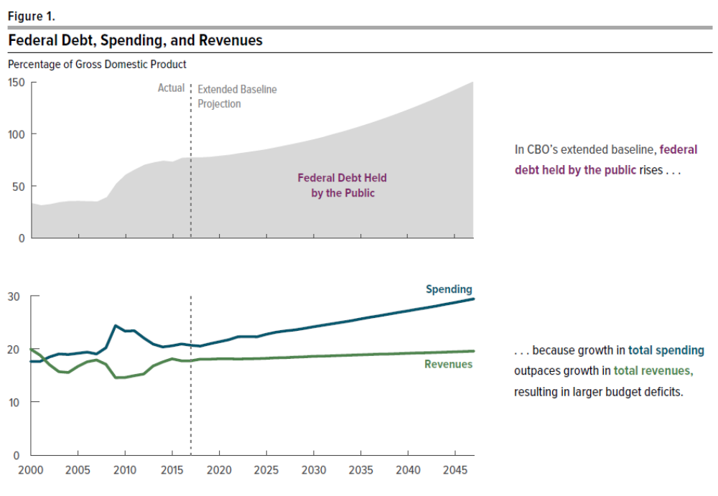
CBOs 2017 Long-term Outlook
Our fiscal situation was unsustainable before TCJA.

Slide 43
The Wisdom of Herb Stein
Herb Stein
  Chair of the Council of Economic Advisors under Nixon and Ford.
  Father of Ben Stein
“If something cannot go on forever…,
it will stop.”

